Slide 1
Multiscale simulation, QM/QM, QM/MM
Instructor: Prof. Tzuhsiung (Nick) Yang
Email: tyang@mx.nthu.edu.tw
Time: M5/6
Room: NTHU Library Comp Lab II
Notes:
Rafael Gomez

Slide 2
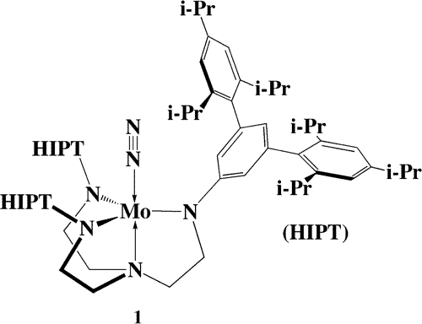
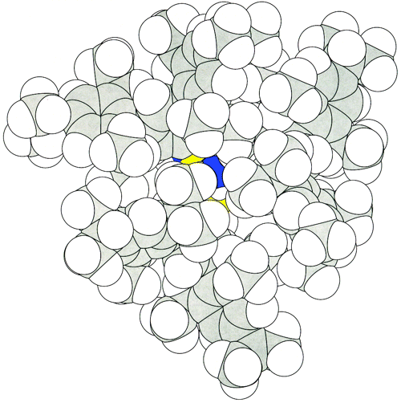
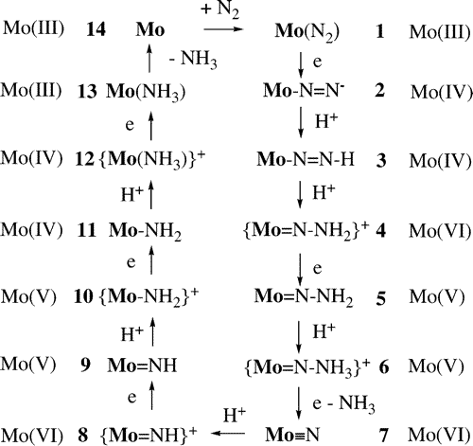
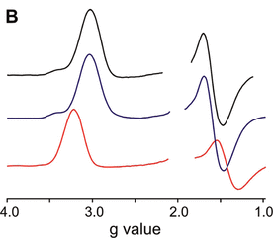
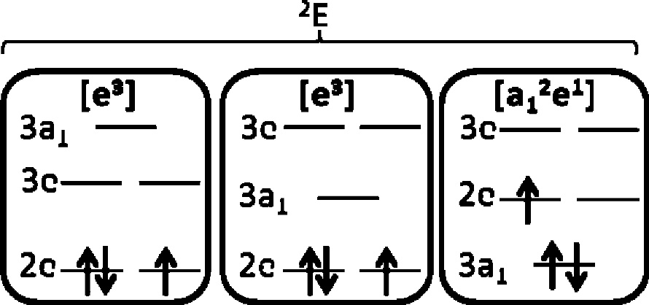
Model complex
(1) Schrock, R. R. Catalytic Reduction of Dinitrogen to Ammonia at a Single Molybdenum Center. Acc. Chem. Res. 2005, 38 (12), 955–962.
(2) Yandulov, D. V.; Schrock, R. R. Catalytic Reduction of Dinitrogen to Ammonia at a Single Molybdenum Center. Science 2003, 301 (5629), 76–78. (3) McNaughton, R. L.; Roemelt, M.; Chin, J. M.; Schrock, R. R.; Neese, F.; Hoffman, B. M. Experimental and Theoretical EPR Study of Jahn−Teller-Active [HIPTN3N]MoL Complexes (L = N2, CO, NH3). J. Am. Chem. Soc. 2010, 132 (25), 8645–8656.

Slide 3
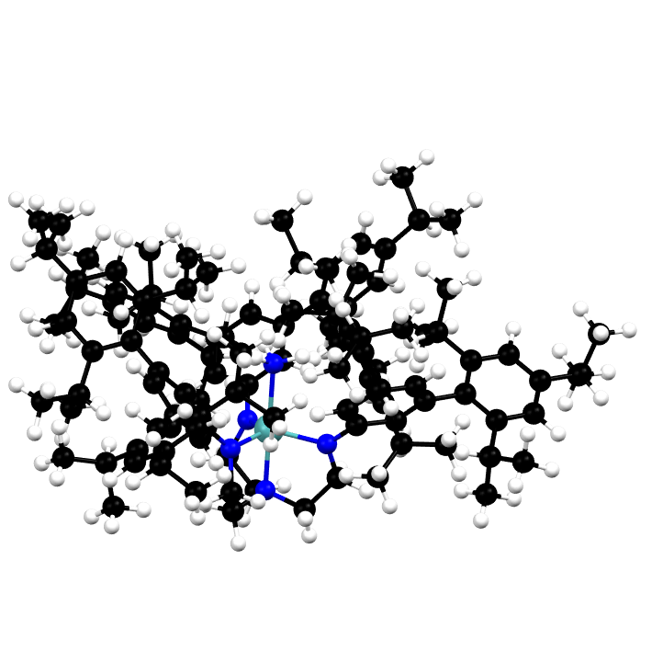
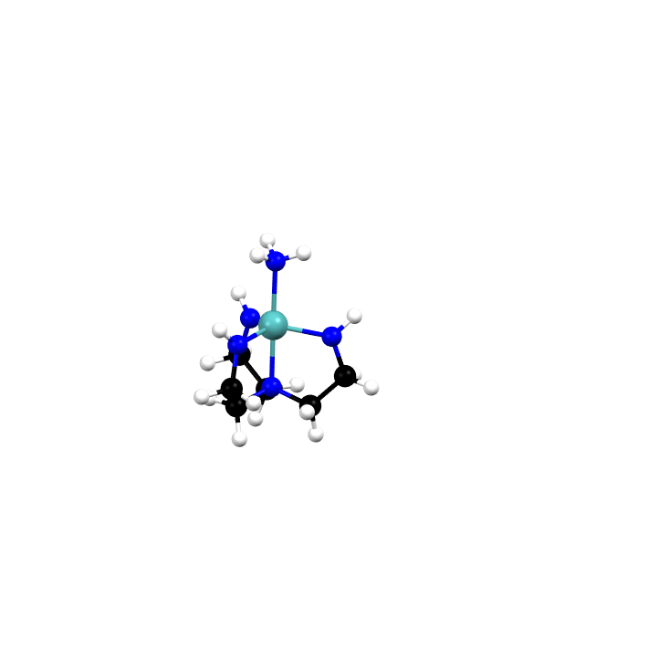
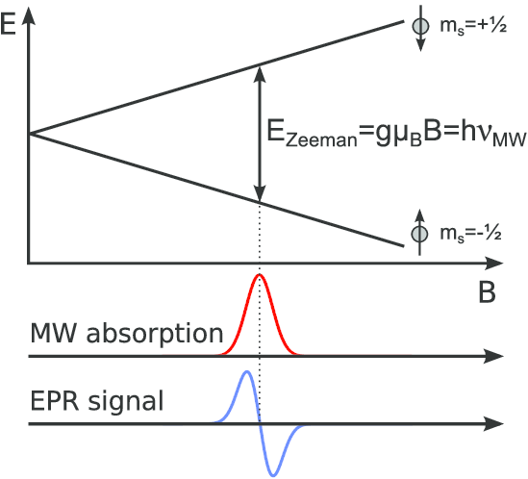
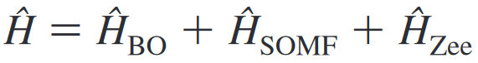
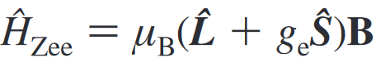
Truncation

Slide 4
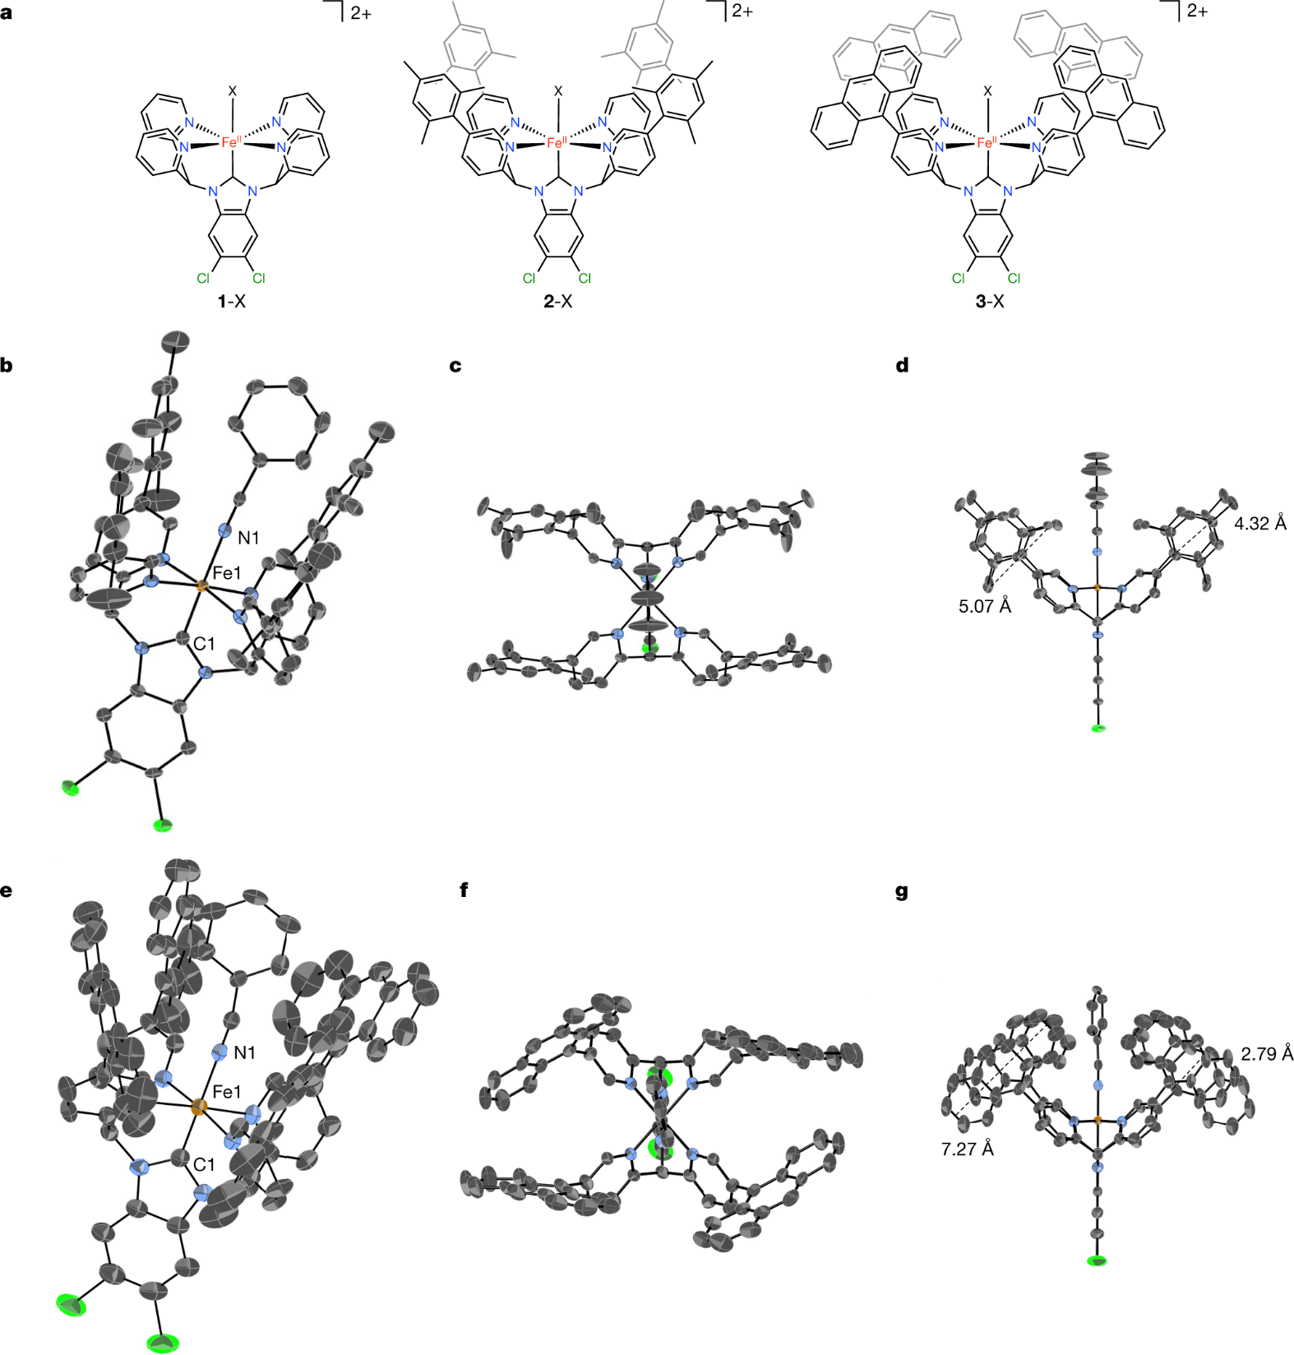
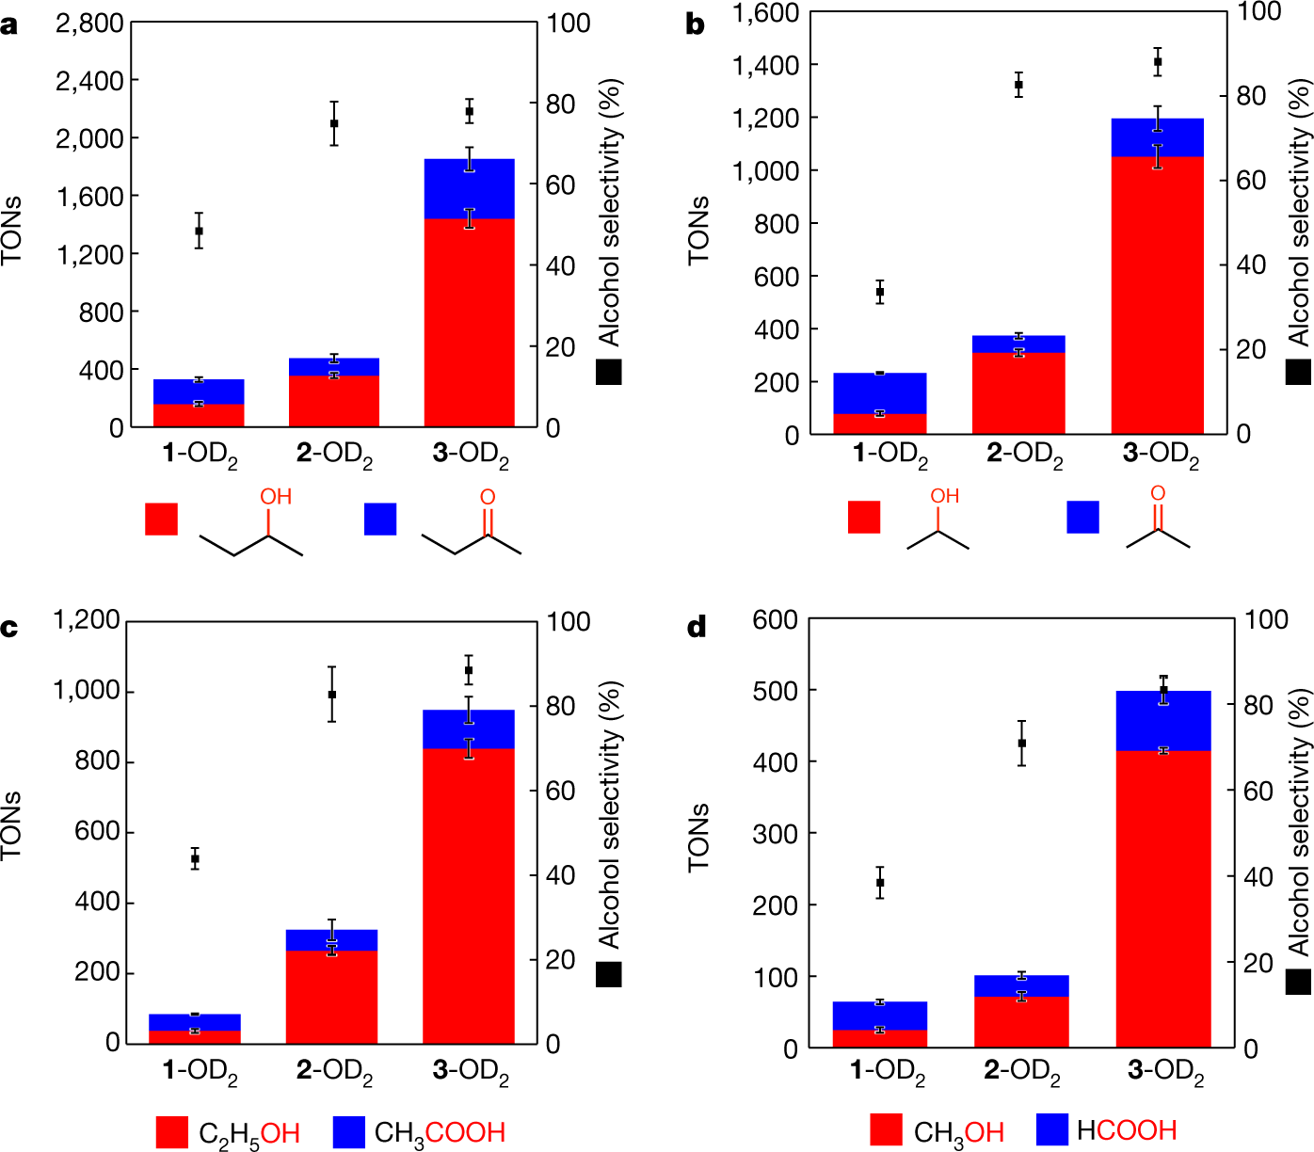

But can we always do it?
Fujisaki, H.; Ishizuka, T.; Kotani, H.; Shiota, Y.; Yoshizawa, K.; Kojima, T. Selective Methane Oxidation by Molecular Iron Catalysts in Aqueous Medium. Nature 2023, 616 (7957), 476–481.

Slide 5
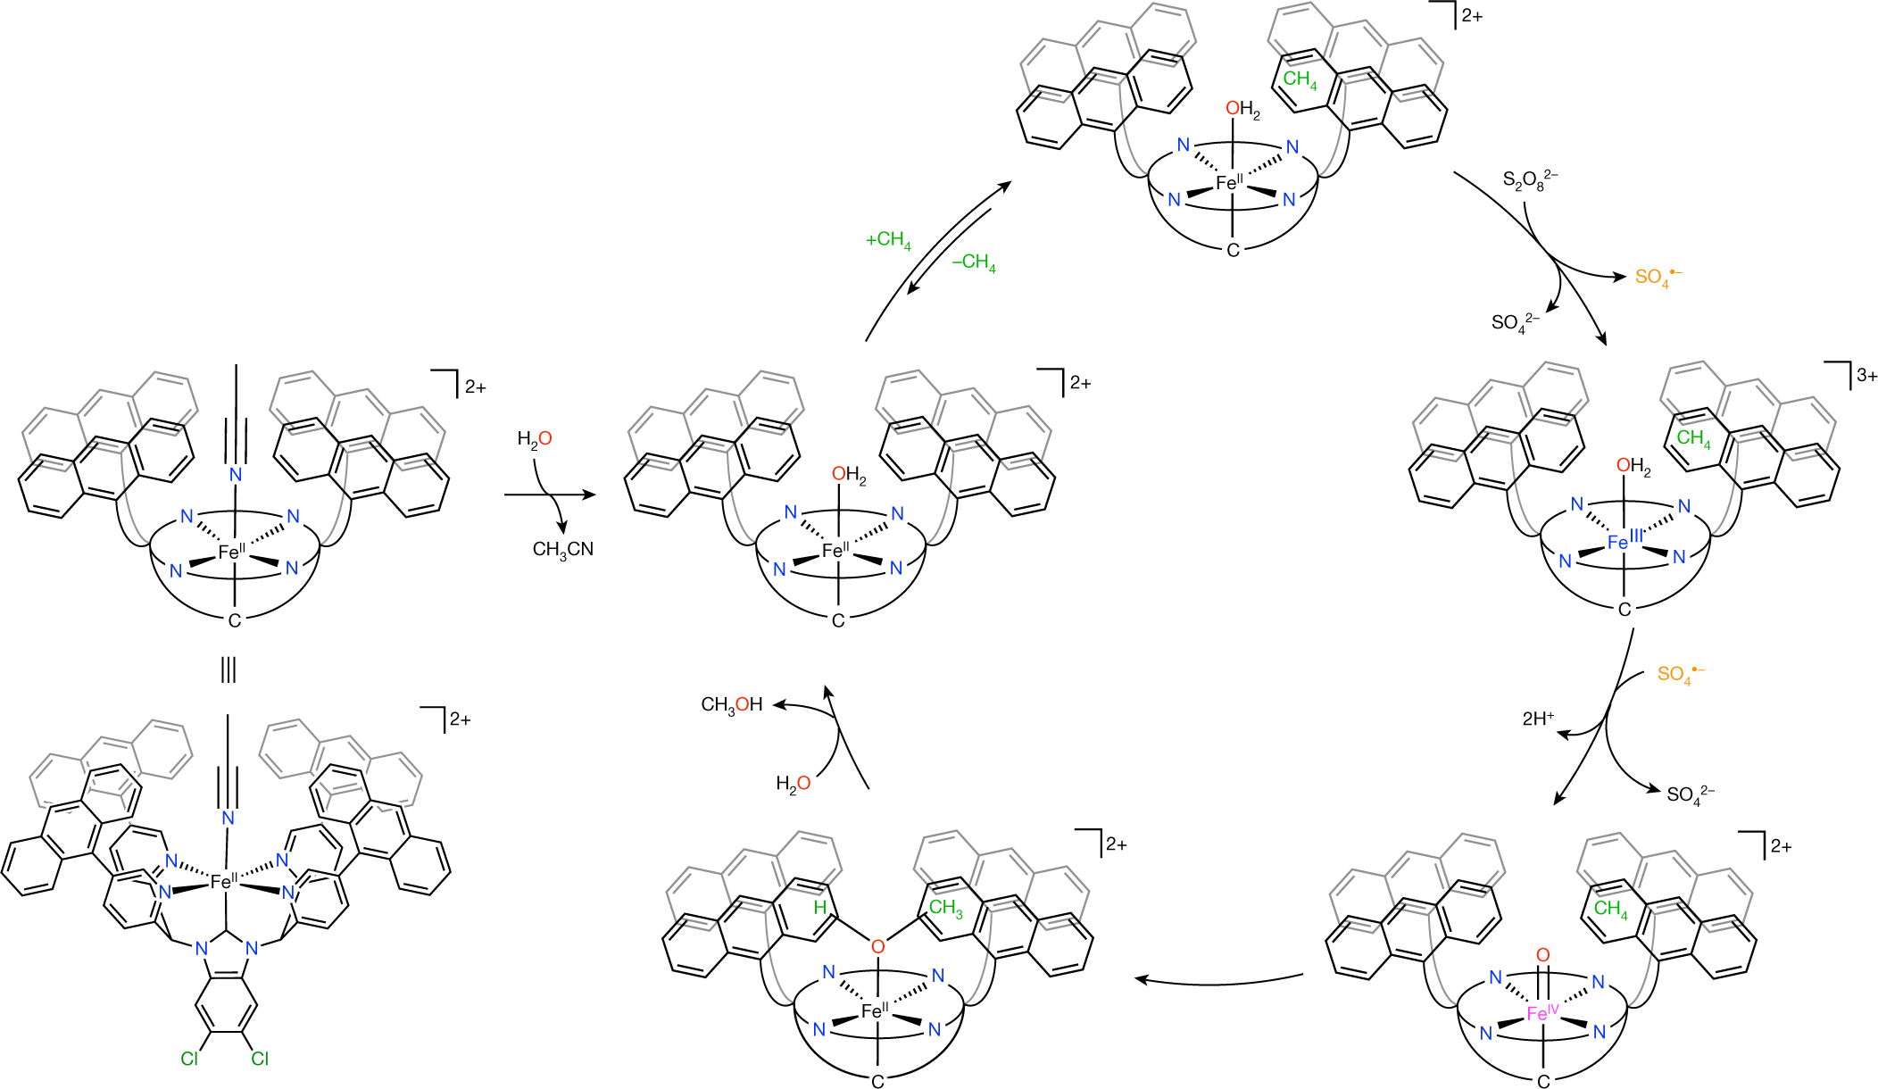
But can we always do it?
Fujisaki, H.; Ishizuka, T.; Kotani, H.; Shiota, Y.; Yoshizawa, K.; Kojima, T. Selective Methane Oxidation by Molecular Iron Catalysts in Aqueous Medium. Nature 2023, 616 (7957), 476–481.

Slide 6
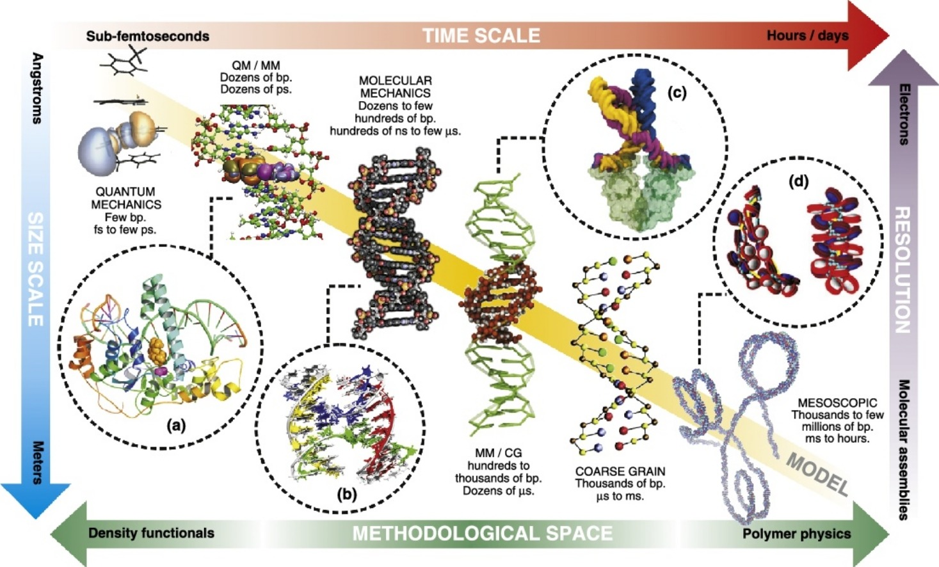
Multiscale simulation
Dans, P. D.; Walther, J.; Gómez, H.; Orozco, M. Multiscale Simulation of DNA. Current Opinion in Structural Biology 2016, 37, 29–45.

Slide 7
Multiscale simulation
Dans, P. D.; Walther, J.; Gómez, H.; Orozco, M. Multiscale Simulation of DNA. Current Opinion in Structural Biology 2016, 37, 29–45.

Slide 8
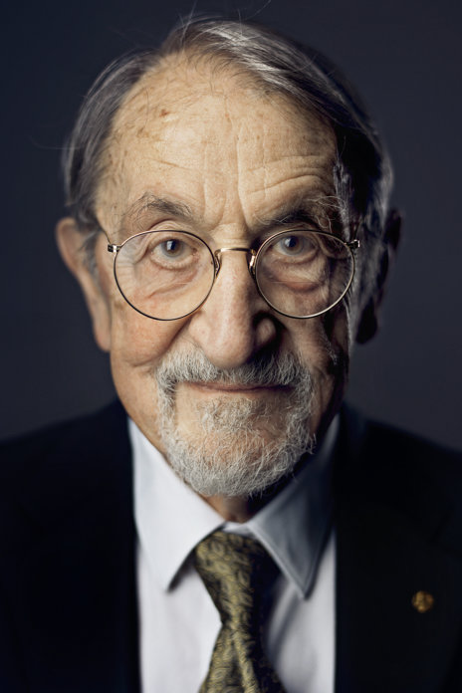
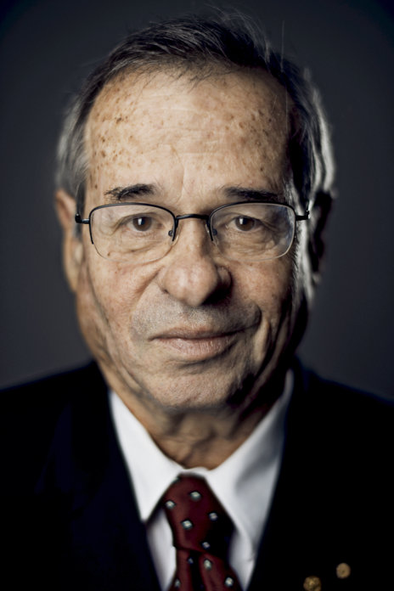
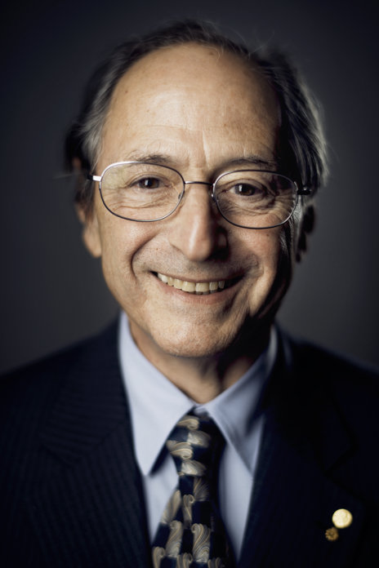
Nobel Prize in Chem 2013
Prize motivation: “for the development of multiscale models for complex chemical systems”
Martin Karplus
Arieh Warshel
Michael Levitt

Slide 9
Interactive
Go into Exercise1
Visualize the xyz file by Avogadro. Which atoms do you think should be treated with QM?
Now check “Mo-HIPT-NH3_0_2_bp86_xtb_lanl2dz_6-31gpol.opt.inp”. Does the input file include atoms that conform to your idea earlier?
If so, submit opt.sub and qmqm.sub

Slide 10
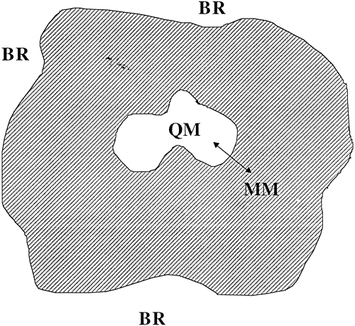
Multiscale simulation
The idea behind multiscale simulation is to combine models at different levels of detail to simulate the behavior of a system as a whole.
There are several combinations commonly used:
QM/QM2, where QM2 is a lower level QM method such as DFT tight binding (DFTB such as extended tight binding XTB), semi-empirical methods (PM6, AM3, etc).
QM/MM, where MM is molecular mechanics in which atoms in molecules are treated as charged balls on springs (to be continued).

Slide 11
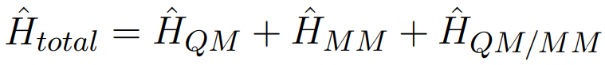
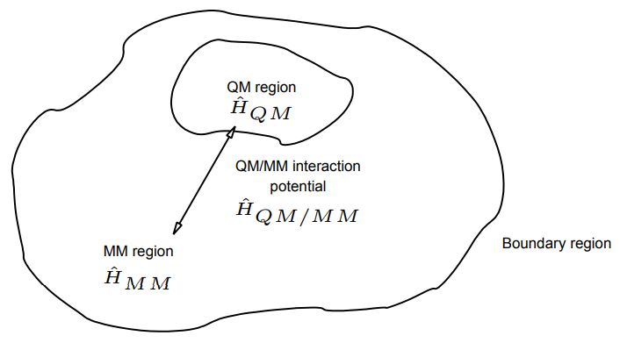
QM/MM
Partition the whole system into a region treated by QM and its surroundings by MM.
The Hamiltonian to describe the system contains that describe the QM part, the MM part, and the interacting part (QM/MM region).

Slide 12
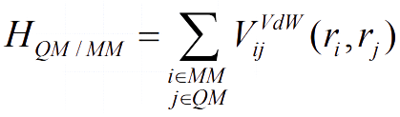
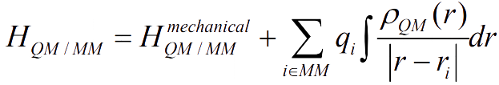
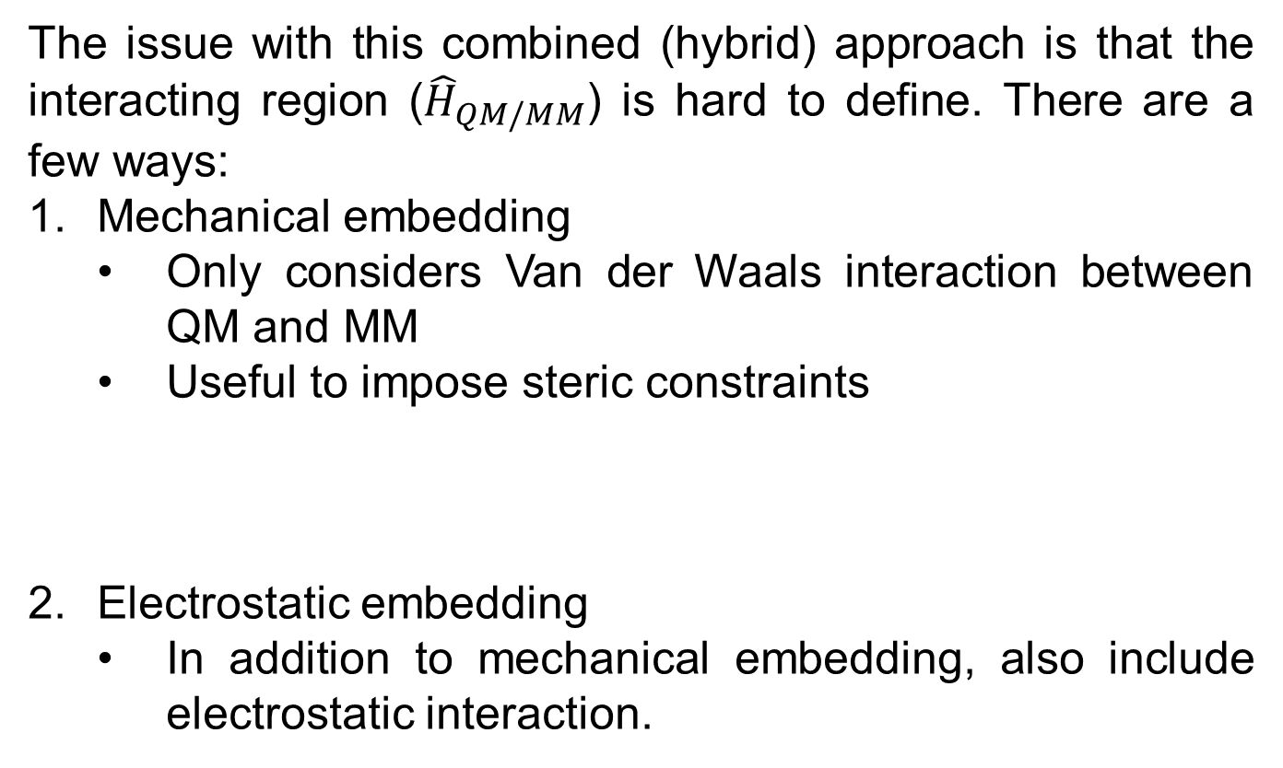
QM/MM
The issue with this combined (hybrid) approach is that the interacting region (${\hat{H}}_{QM/MM}$) is hard to define. There are a few ways:
Mechanical embedding
Only considers Van der Waals interaction between QM and MM
Useful to impose steric constraints
Electrostatic embedding
In addition to mechanical embedding, also include electrostatic interaction.

Slide 13
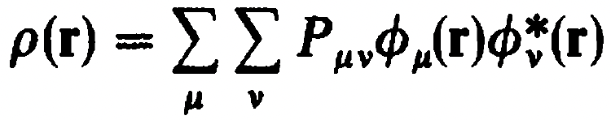
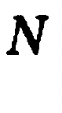
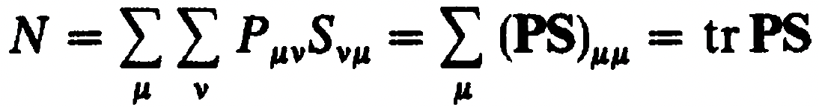
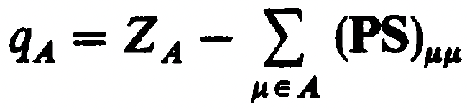
Mulliken charges
Recall that charge density is defined as
Rewrite using the definition of the overlap matrix
The net charge associated with an atom is thus
This definition is Mulliken’s definition of atomic charge.

Slide 14

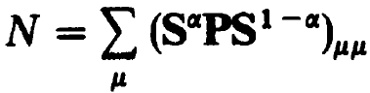
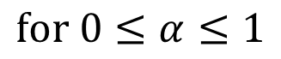
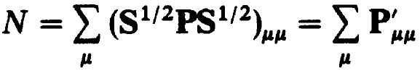
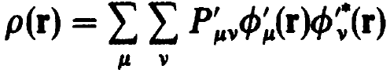
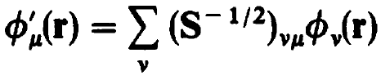
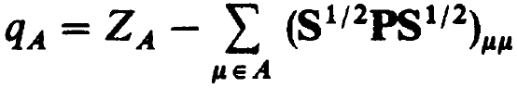
Loewdin charges
Since
We can rewrite
which is the charge density in orthonormal basis
And the corresponding atom charge is
This definition is Loewdin’s definition of atomic charge.

Slide 15
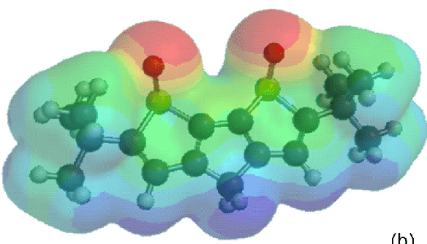
CHELPG charges
CHELPG is the abbreviation for charges from the electrostatic potential on a grid. These are the atomic charges that are best fit to the molecular electrostatic potential, evaluated on a real-space grid outside of the Van der Waals region, and subject to the constraint that the sum of the charges equals to the charge of the molecule.

Slide 16
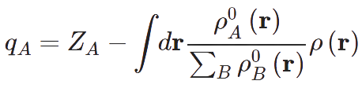
Hirshfeld charges
Hirshfeld charges are calculated by integrating over the ratio of atomic charge of A to the sum of the atomic charges of the rest of the atoms.

Slide 17
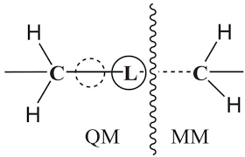
Boundary treatment
When the boundary between the QM and MM regions are not well described by pure electrostatic interactions, e.g. bonding interactions, link atoms are usually used to preserve the geometry of the system (Kollman).
Link atoms satisfy the valence of the QM region and are used to calculate MM bond terms. However, link atoms usually do not have the required charge polarization effect to correctly describe the change of electron density.

Slide 18
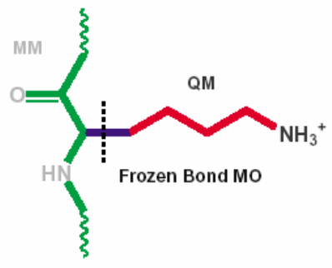
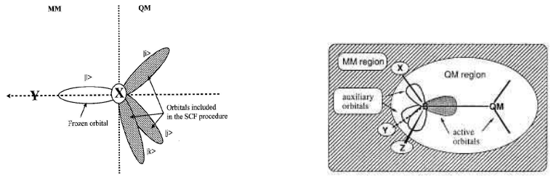
Boundary treatment
To solve the issue with the poor description of the effect of the replaced groups by link atoms, different ways of adjusting the description of link atoms:
Adjusting the electronegativity of link atoms to be equivalent to the replaced atoms (Thiel).
Keep the MO between the QM-MM bond frozen during QM SCF.
Generalized Hybrid Orbital approach: Includes the QM-MM orbital in the SCF.

Slide 19

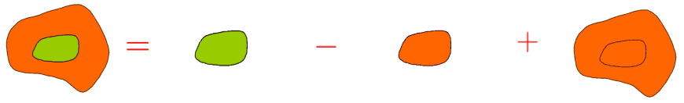
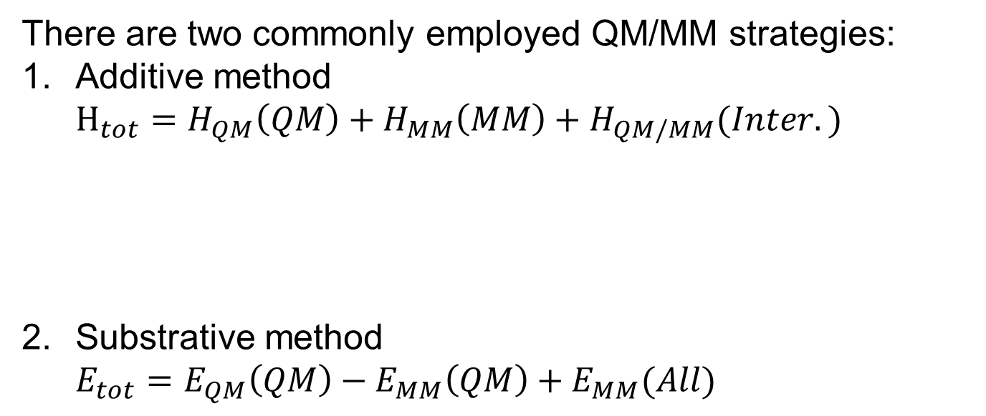
QM/MM strategies
There are two commonly employed QM/MM strategies:
Additive method
$$H_{tot}=H_{QM}\left(QM\right)+H_{MM}\left(MM\right)+H_{QM/MM}(Inter.)$$
Substrative method
$$E_{tot}=E_{QM}\left(QM\right)−E_{MM}\left(QM\right)+E_{MM}(All)$$

Slide 20
ONIOM
ONIOM stands for “Our own N-layered INtegrated molecular Orbital and Molecular mechanics.” This method divides the system into the “real” (full) system and the “model” (subset) and treats the model at high level and the real at low level.
$$E_{tot}=E_{high}\left(model\right)−E_{low}\left(model\right)+E_{lower}(real)$$
This is a type of subtractive strategy that allows straightforward extension to any combinations of high and low level methods such as QM/QM2, QM/SQM, QM/MM, QM/QM2/MM, etc.

Slide 21
Interactive
 | Crystal | QM/QM2
Mo-NH₃ / Å | 2.169
Mo-N_{amide} / Å | 1.998 2.002 2.011
Mo-N_{amine} / Å | 2.206
N_{amide}-Mo-N_{amide} / º | 116.82 117.46 117.71

Slide 22
Interactive
 | Crystal | QM/QM2
Mo-NH₃ / Å | 2.169 | 2.293
Mo-N_{amide} / Å | 1.998 2.002 2.011 | 1.981 2.005 2.009
Mo-N_{amine} / Å | 2.206 | 2.127
N_{amide}-Mo-N_{amide} / º | 116.82 117.46 117.71 | 116.00 116.58 121.60

Slide 23
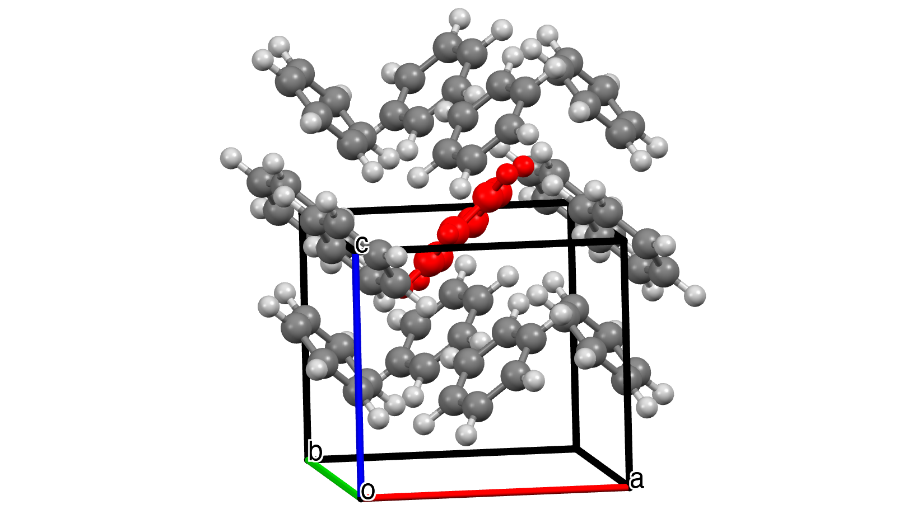
Interactive

Slide 24
Multiscale simulation
Dans, P. D.; Walther, J.; Gómez, H.; Orozco, M. Multiscale Simulation of DNA. Current Opinion in Structural Biology 2016, 37, 29–45.

Slide 25
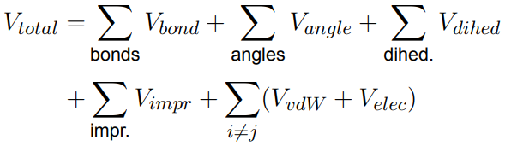
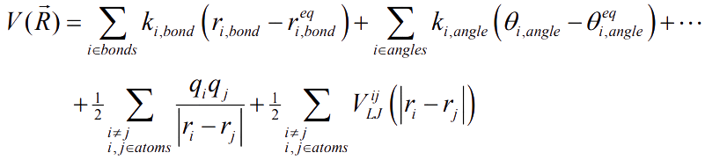
Molecular Mechanics
Atoms in molecules are treated as charged balls on springs and the interactions are calculated by parameterized force constants and bonds, angles, and dihedral angles.
Electrons are treated implicitly – no handling of polarization or electron transfer. This renders this method usually inappropriate to handle bond breaking/forming, excited states, electron transfer, etc.

Slide 26
Interactive
Login to ${USER}@ln01.twnia2.twcc.aii

